Slide 1
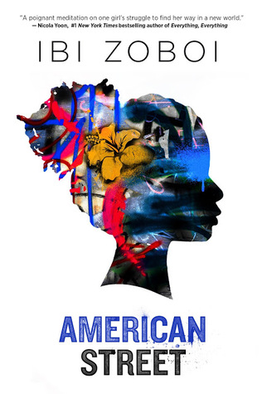
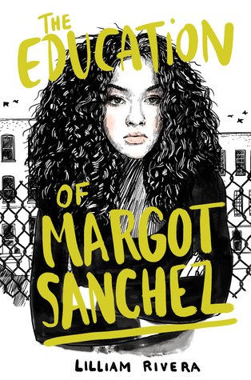
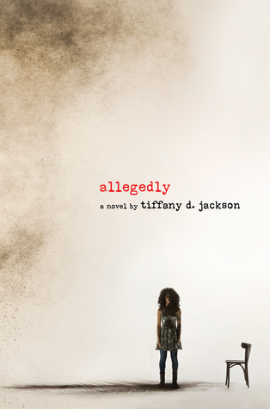
Diversity by the book: Speed Dating
Melissa Taylor, Teen Outreach Librarian
Jefferson County Public Library

Slide 2
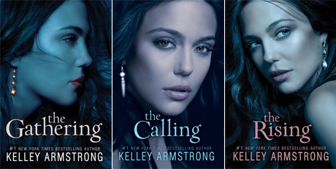
White Washing in Teen Books
The reality is that Elisa is overweight, brown skinned (possibly Hispanic or Arab), and more than a little awkward. She’s also the “Godstone,” or chosen one, which makes her all the more self conscious about what she sees as her physical shortcomings.
You’d never know it looking at these covers, but the Darkness Rising trilogy actually features a 100% Native American protagonist named Maya. And the fact that she is Native American isn’t just a sidebar. It’s critical to the story.
http://www.yalsa.ala.org/thehub/2012/12/10/it-matters-if-youre-black-or-white-the-racism-of-ya-book-covers/

Slide 3
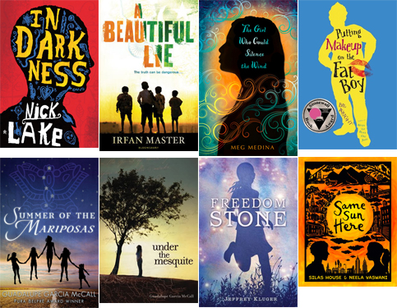
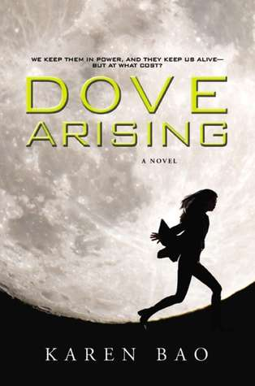
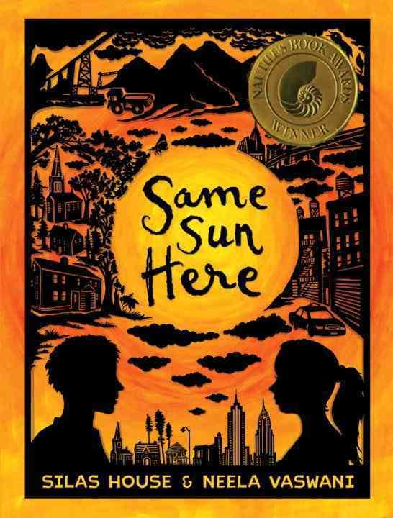
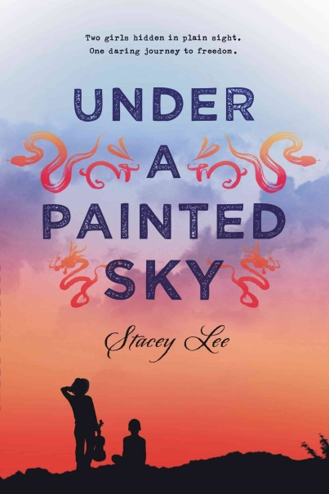
Silhouettes to hide race?

Slide 4
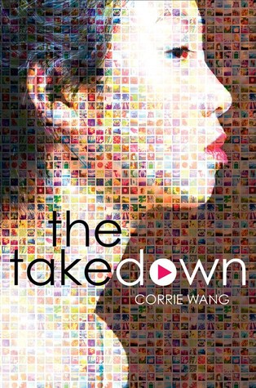
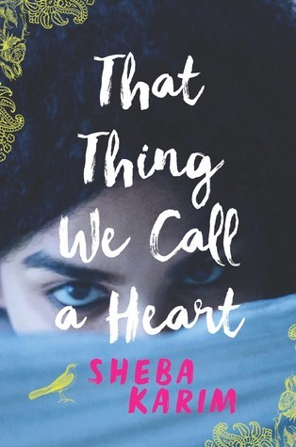
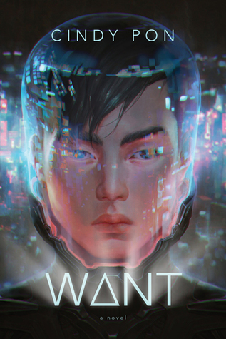
Upcoming Titles…
April 4
April 11
May 9
May 9
May 30
May 30
June 13
August 29

Slide 5
Who’s to blame?
http://writerunboxed.com/2010/04/27/do-authors-choose-their-covers/
What do we do?
Read the books anyway and promote the message/story.
Boycott?
Nah.

Slide 6
Resources:
http://www.yalsa.ala.org/thehub/2012/12/10/it-matters-if-youre-black-or-white-the-racism-of-ya-book-covers/
http://www.slj.com/2009/04/standards/straight-talk-on-race-challenging-the-stereotypes-in-kids-books/#3.%20Is%20the%20cover%20art%20true%20to%20the%20story?
http://www.malindalo.com/2011/01/dont-judge-a-book-by-its-cover/
http://bookriot.com/2015/07/10/combating-fat-phobia-ya-lit/
https://bookishnessandtea.wordpress.com/2016/12/26/60-diverse-books-to-look-forward-to-in-2017/
http://bookriot.com/2016/11/28/faces-color-2017-ya-books/
http://www.cnn.com/2014/04/09/living/young-adult-books-diversity-identity/
http://www.npr.org/sections/codeswitch/2016/08/09/483875698/diversity-in-book-publishing-isnt-just-about-writers-marketing-matters-too
https://www.bustle.com/articles/186052-library-magazine-faces-intense-criticism-over-controversial-review-of-book-with-bisexual-female-character

